Slide 1

INTERNSHIP Review
Jayanthi sai TANAY | 221910301027

Slide 2
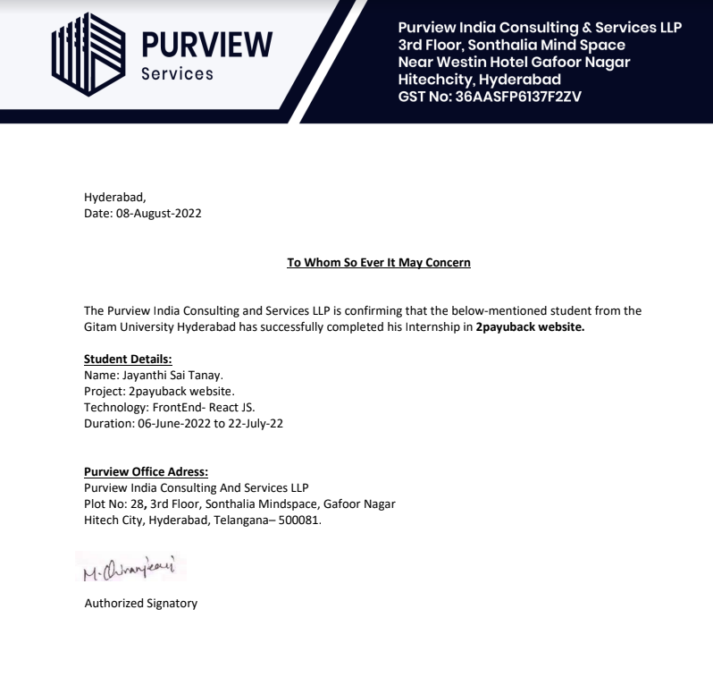
INTERNSHIP CERTIFICATE

Slide 3
TECHNOLOGIES Learned as a frontend dev
HTML5:
HTML, or Hypertext Markup Language, is a markup language for the web that defines the structure of web pages.
It is one of the most basic building blocks of every website, so it's crucial to learn if you want to have a career in web development.
CSS:
Cascading Style Sheets (CSS) is a stylesheet language used to describe the presentation of a document written in HTML.CSS describes how elements should be rendered on screen, on paper, in speech, or on other media.
JavaScript:
JavaScript is used by programmers across the world to create dynamic and interactive web content like applications and browsers.
ReactJS:
ReactJS is an open-source JavaScript library that is used for building user interfaces specifically for single-page applications. It's used for handling the view layer for web and mobile apps. React also allows us to create reusable UI components.

Slide 4
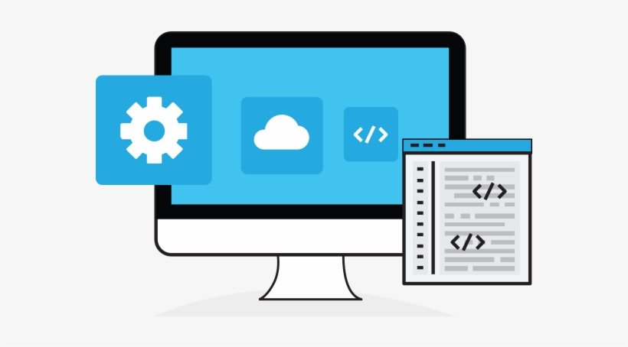

About project
The company asked us to a design and build a web application for a financial application 2payUback. The application allows users to register and have the option of adding friends and family. After which they can request or approve loans, the application keeps track of payment transaction and also sends out monthly reminders via email.

Slide 5
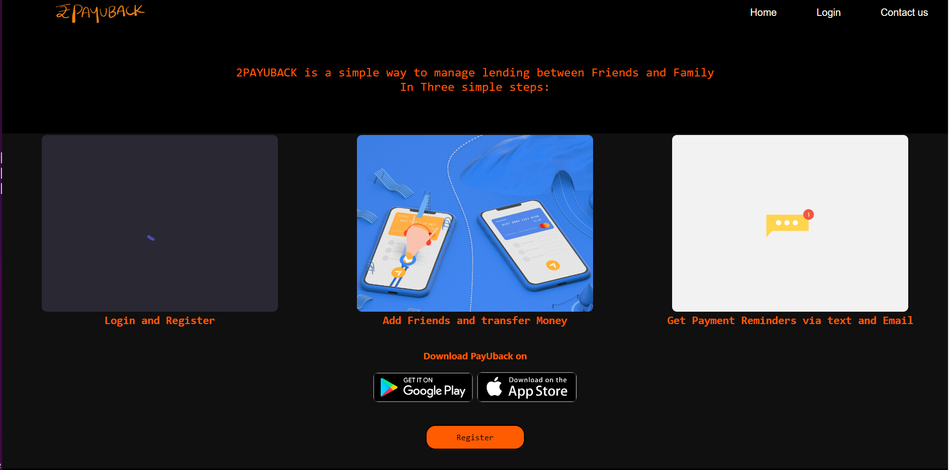
Home page

Slide 6
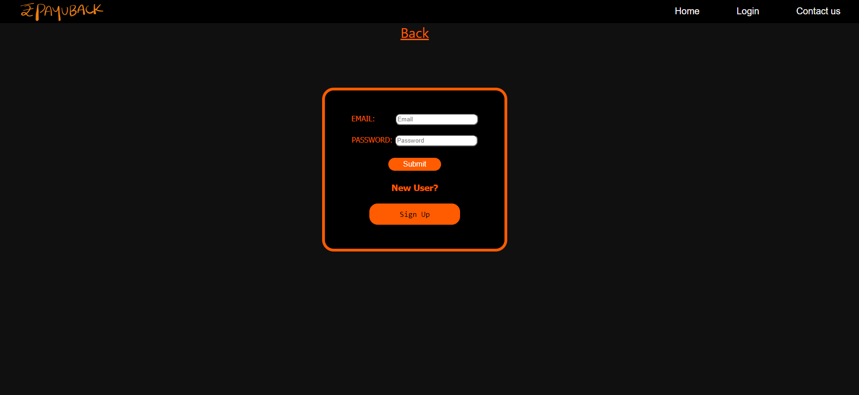
Login page

Slide 7
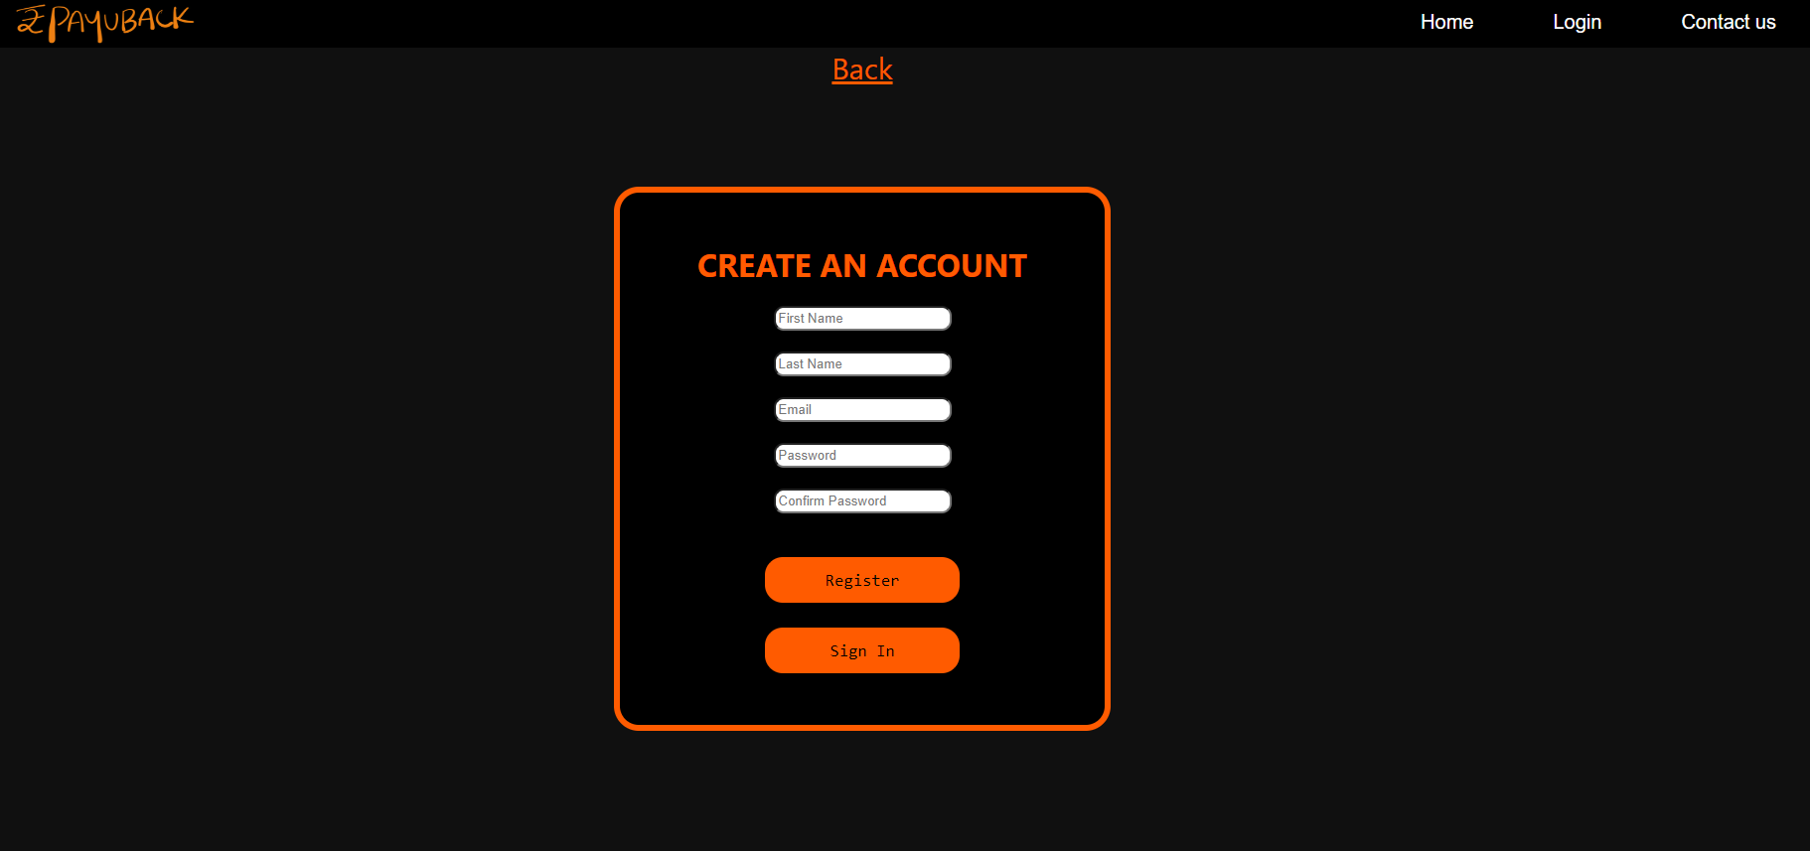
Registration page

Slide 8
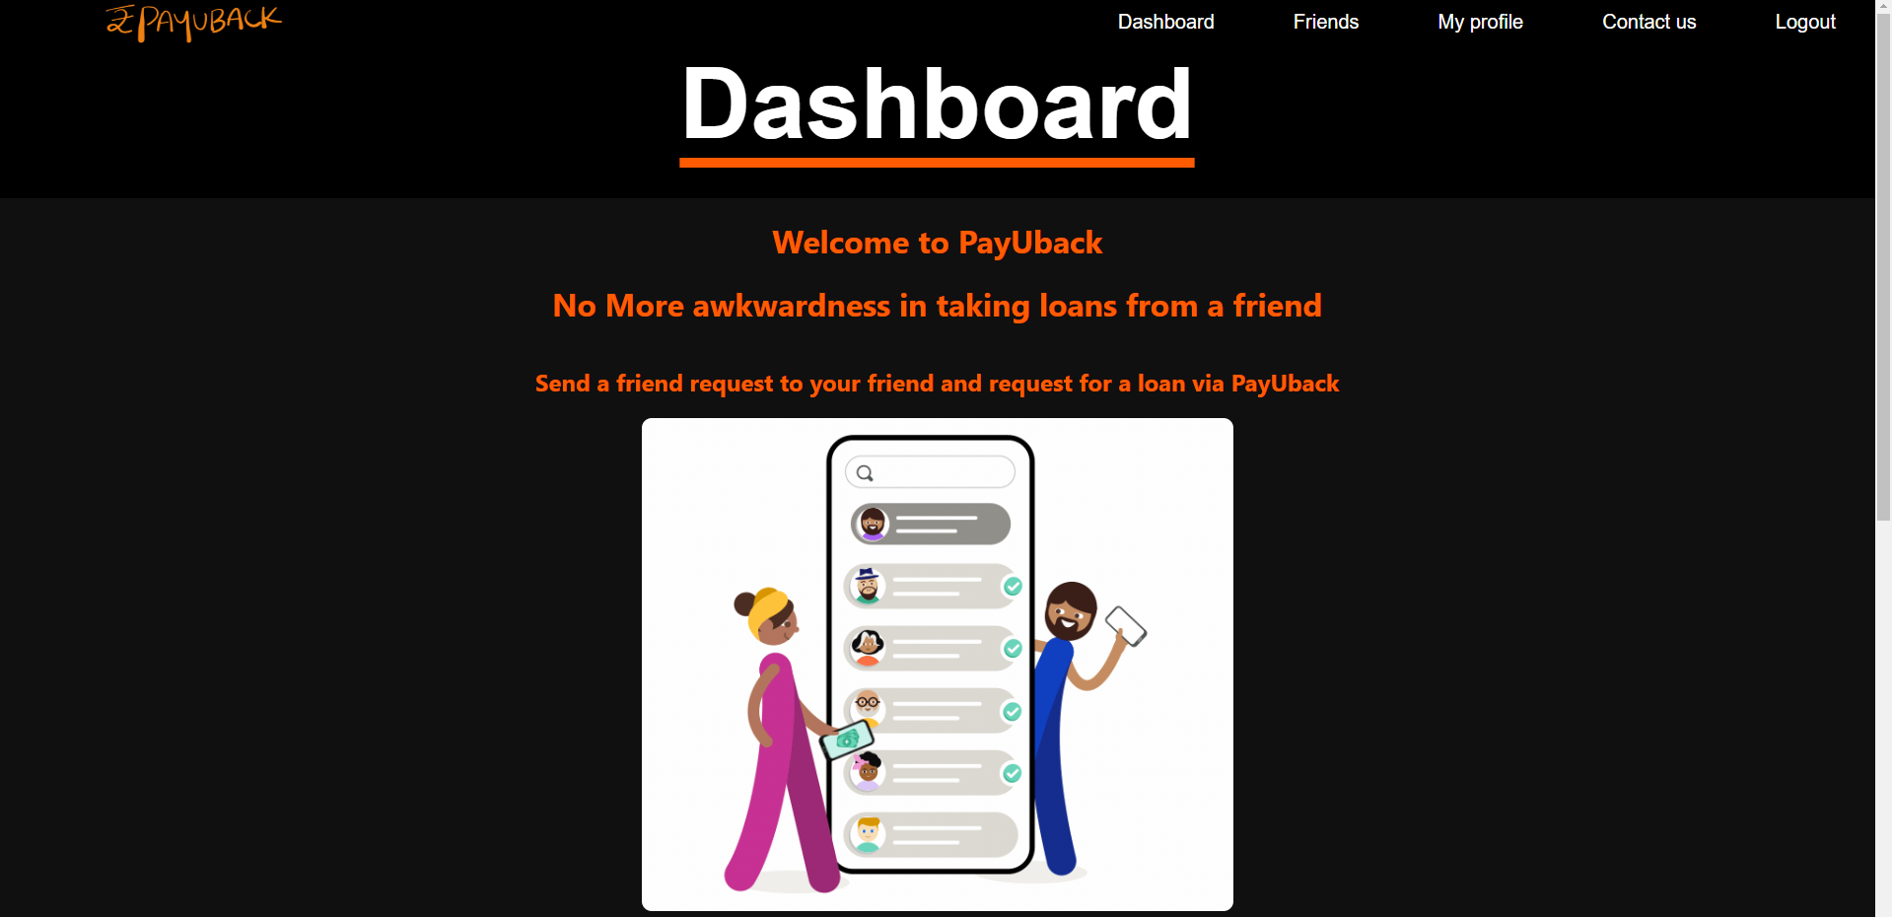
DASHBOARD

Slide 9
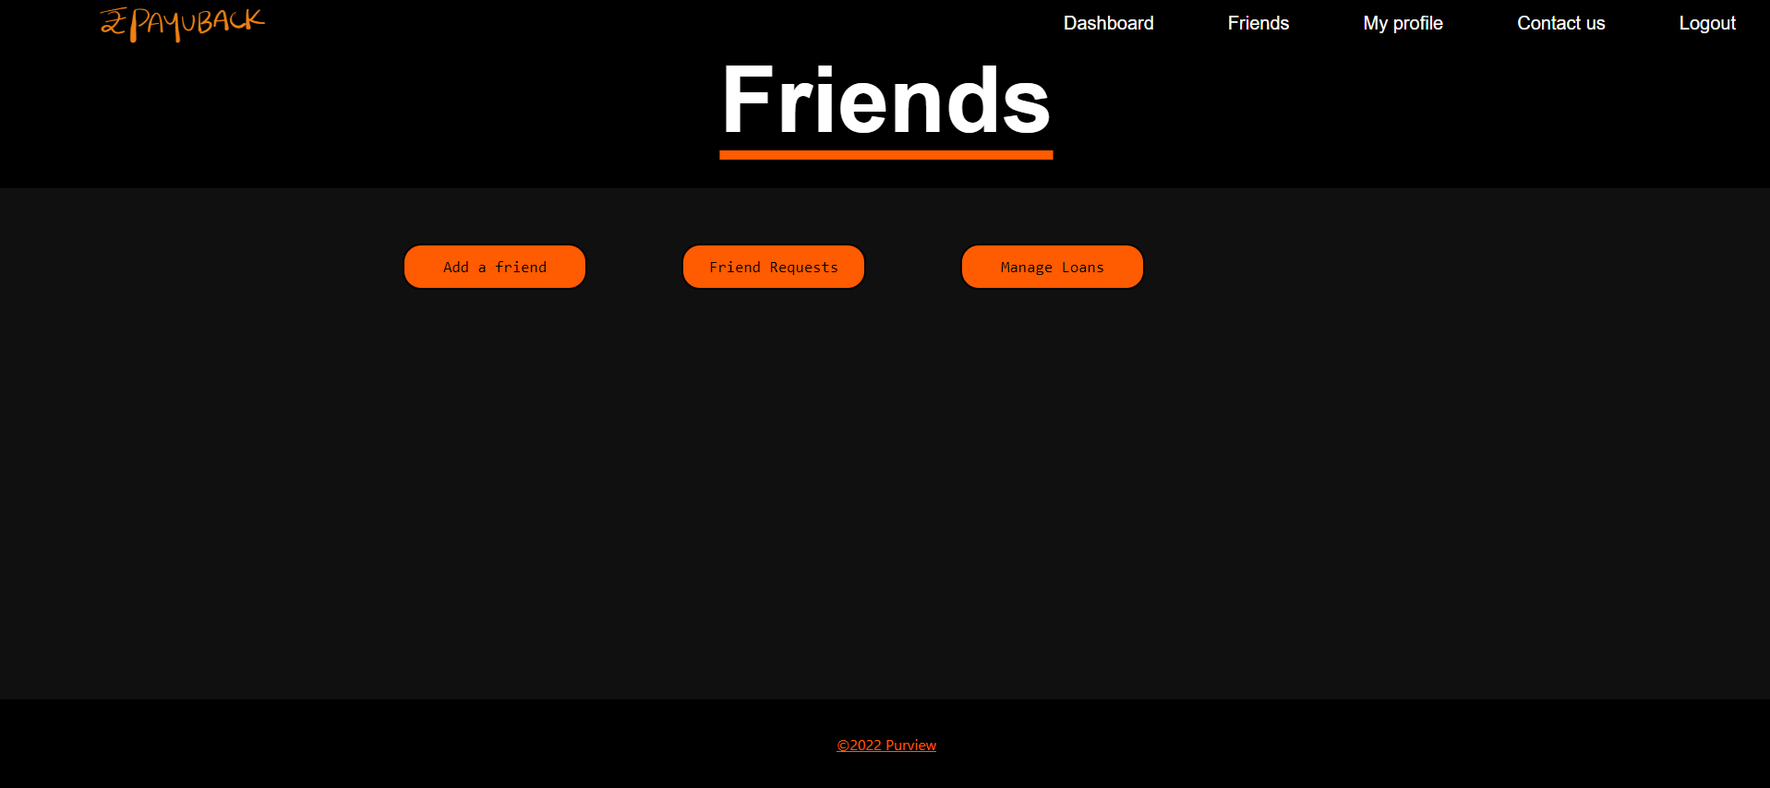
Friends page

Slide 10
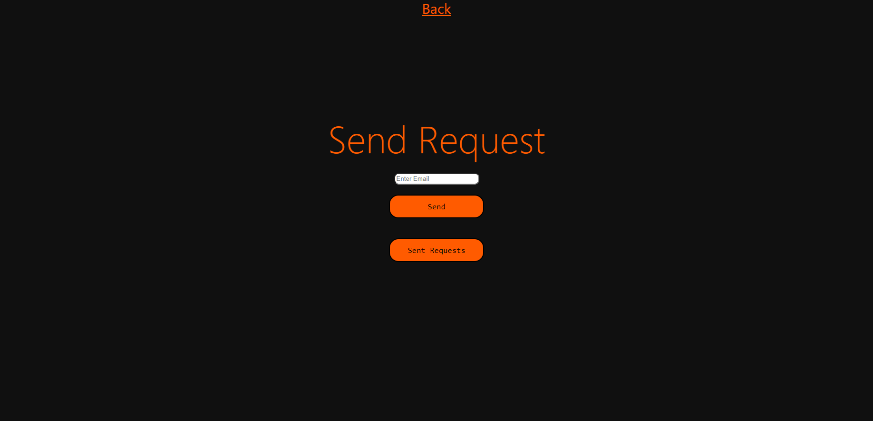
Add friend’s page

Slide 11
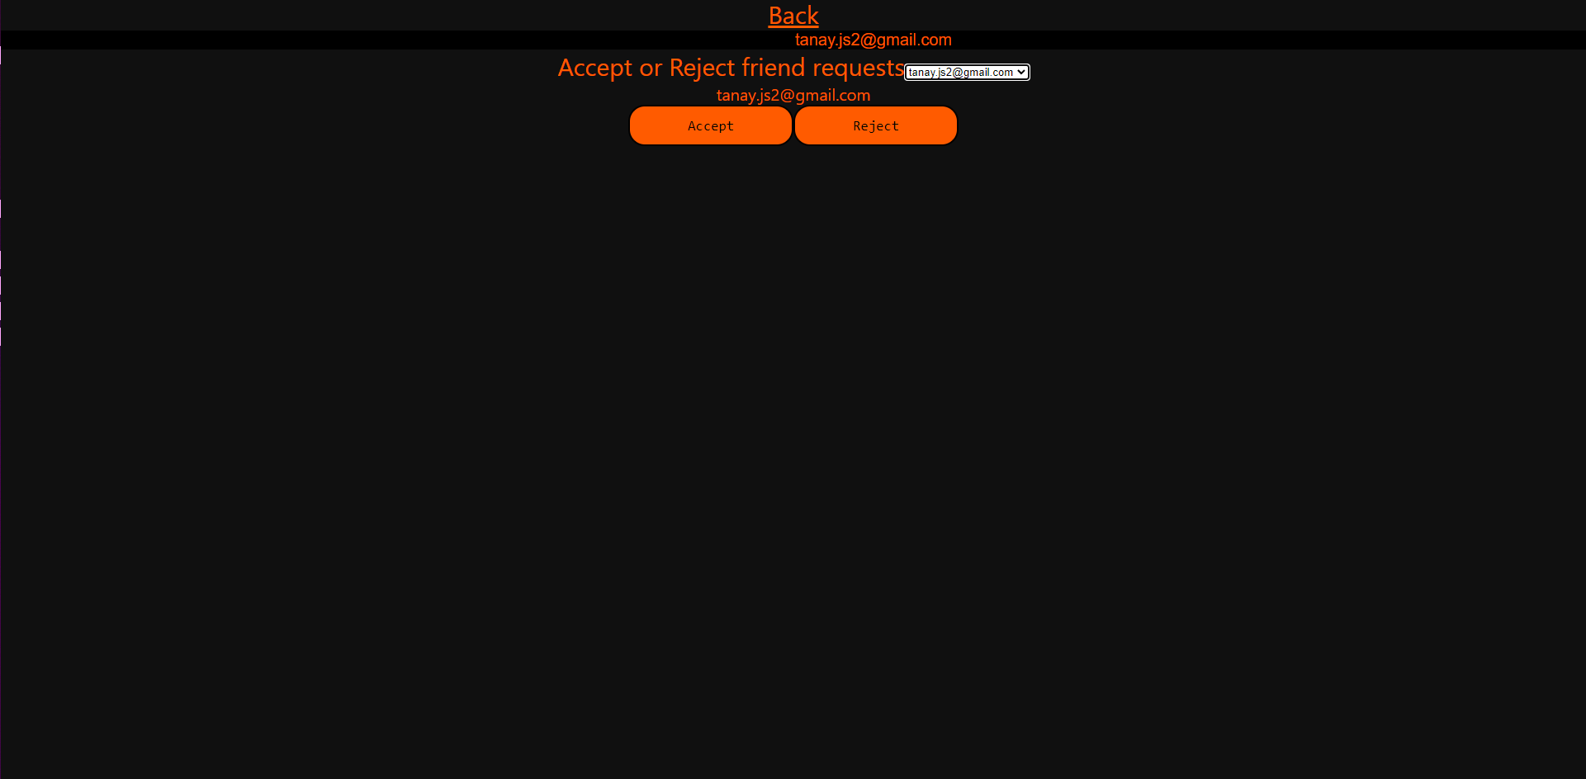
Friend requests page

Slide 12
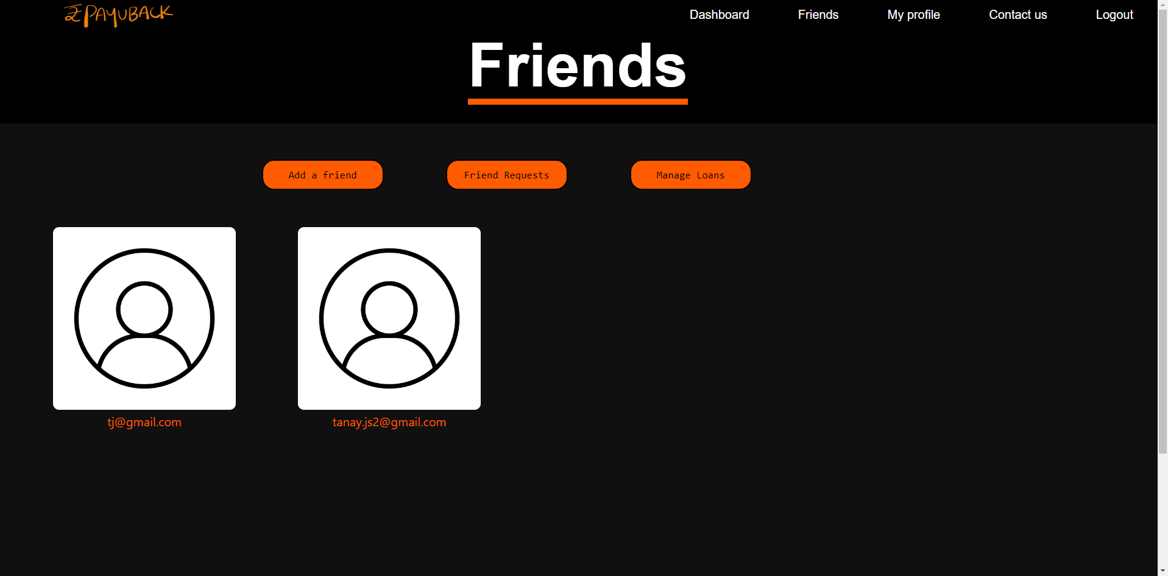
After adding friends

Slide 13
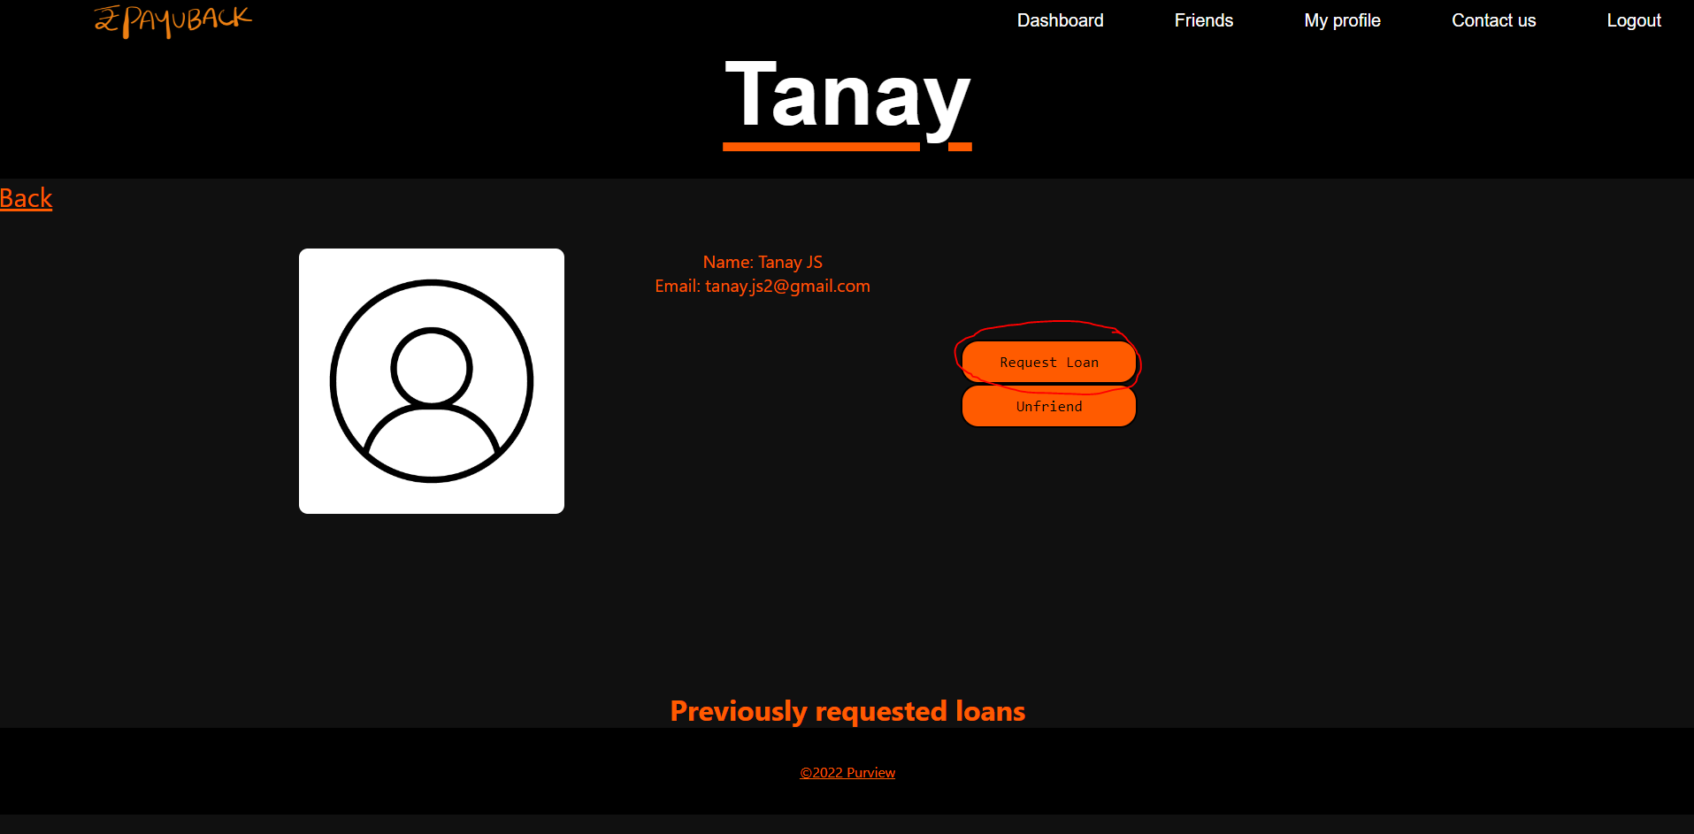
Individual profiles & request loan option

Slide 14
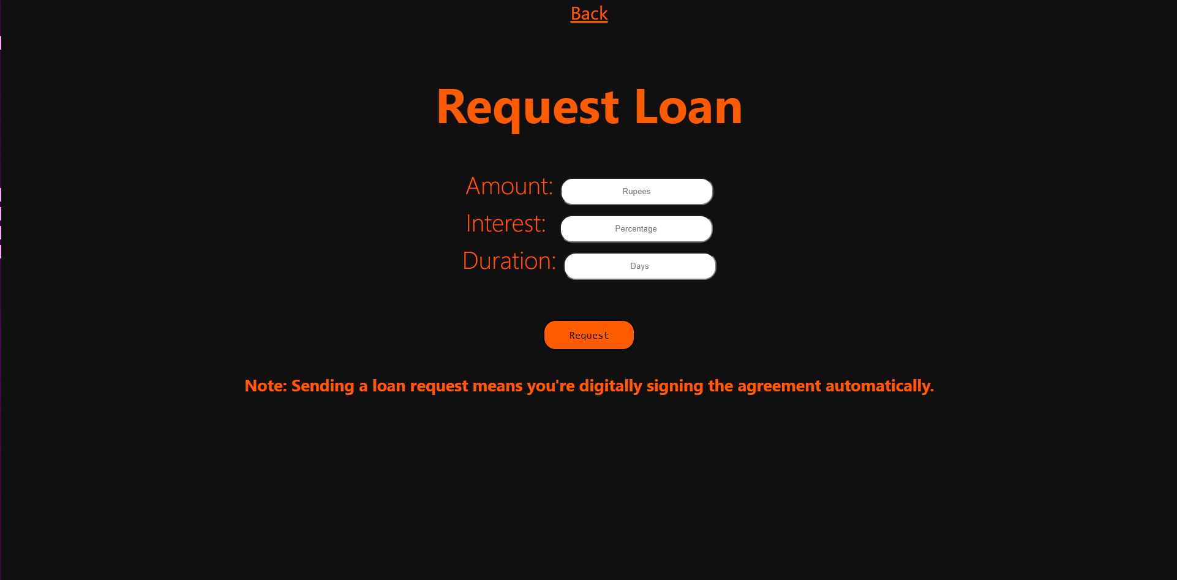
Loan request page

Slide 15
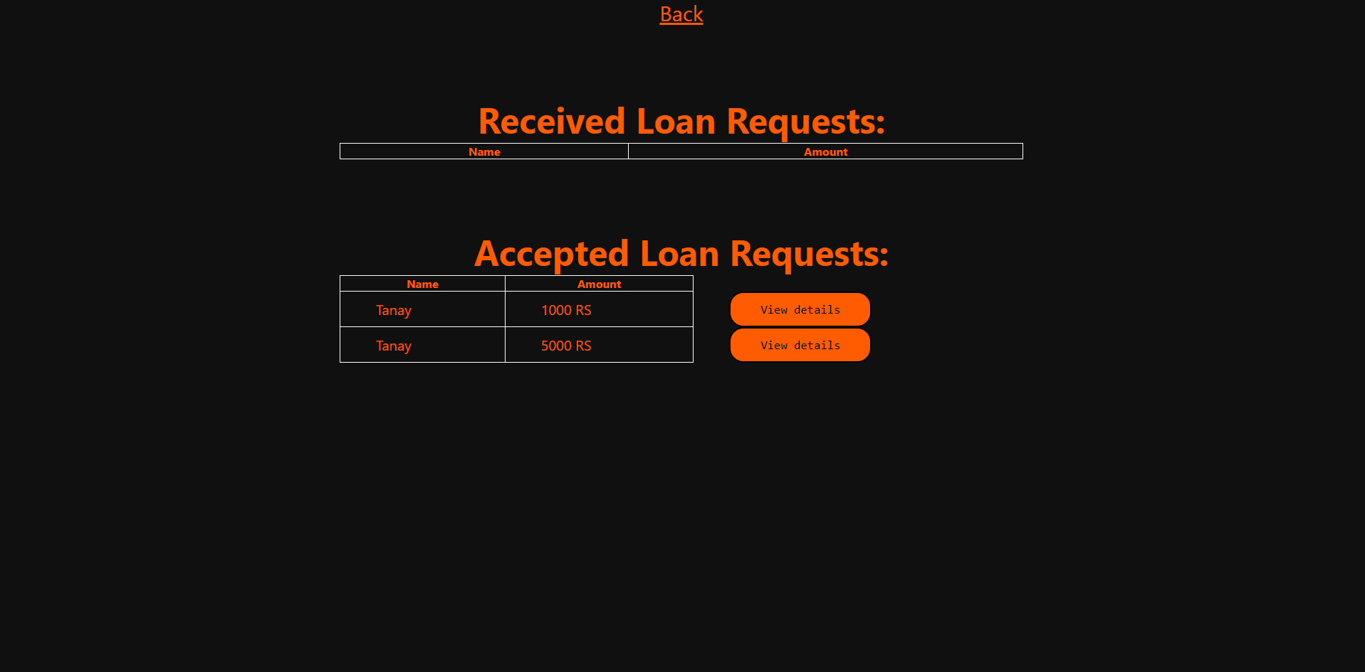
Manage loans page

Slide 16
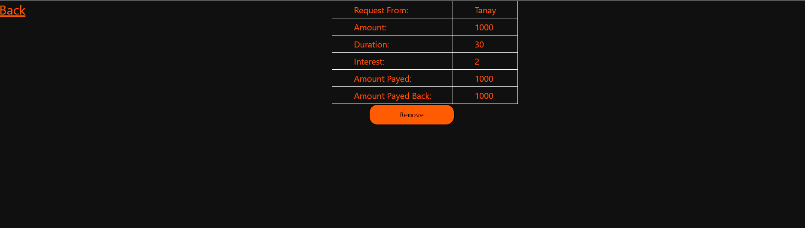
Transaction page

Slide 17
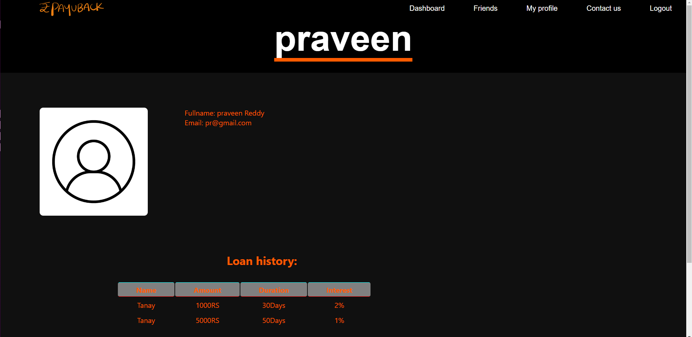
MY profile page

Slide 18
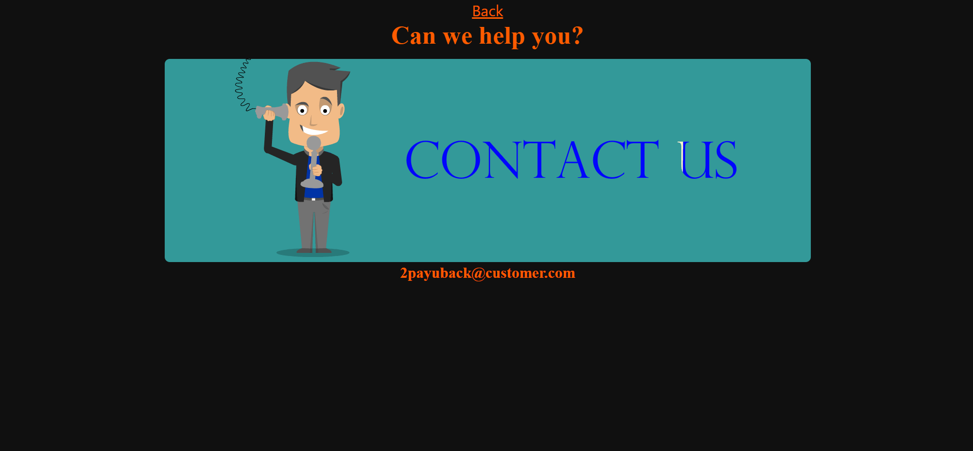
CONTACT US PAGE

Slide 19
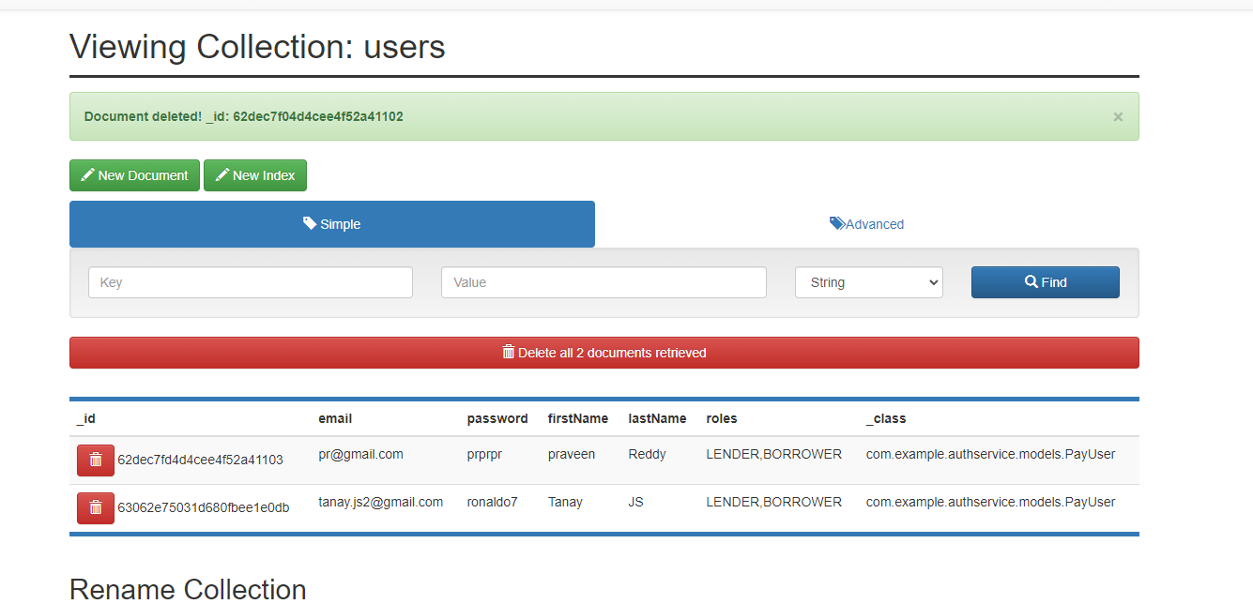
BACKEND USER DATA

Slide 20
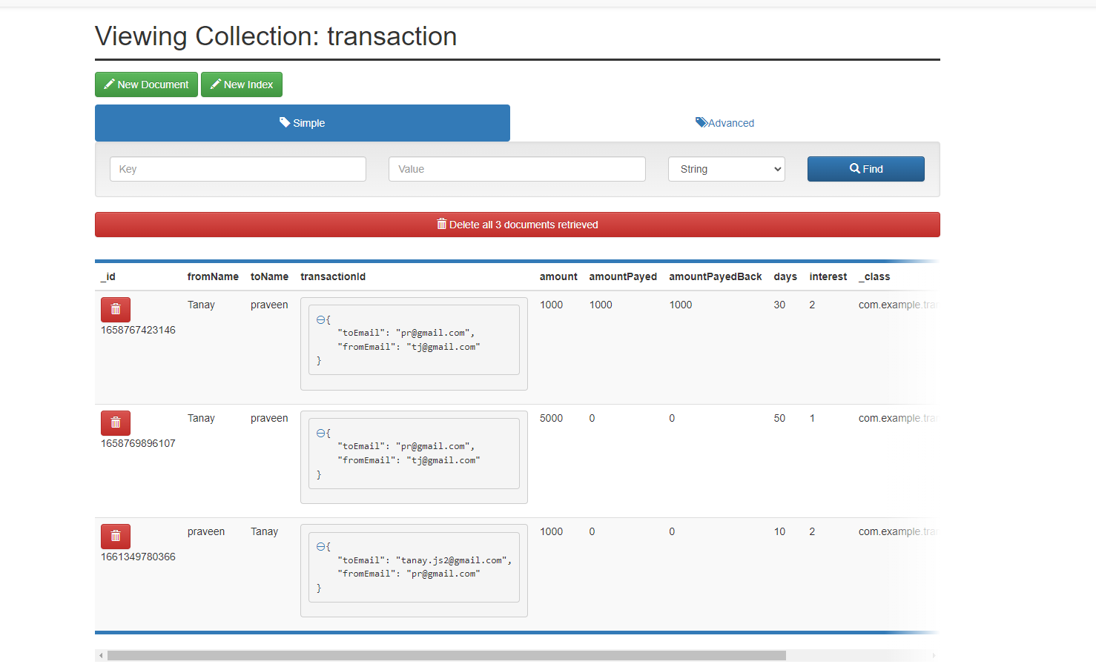
backend transaction data

Slide 21
THANK YOU

